Slide 1

WELCOME TO PRESENTATION

Slide 2

EMPLOYEE MANAGEMENT SYSTEM

Slide 3

WHAT IS EMPLOYEE MANAGEMENT SYSTEM(EMS)
Employee Management System is a distributed application. developed to maintain the details of employees working in any Organization.
The EMS has been developed to overcome from the Old System.
It maintains the information about the Personal and Official details of the employees.

Slide 4
Objectives of our project
This project aims to simplify the task of maintaining records. of the employees of Company.
To develop an well-designed database to store employee information.
Provides full Functional reports to management of Company.
The objective of this project is to provide a Comprehensive approach towards the management of employee information.

Slide 5

EXISTING SYSTEM
The records are maintained in Registers.
Time Consuming process.
Complicated Searching, Editing & Updating.

Slide 6

PROPOSED SYSTEM
Helps in maintaining the Computerized employee details.
Calculate the Salary.
Easy Attendance marking.
Create New Users to
the System accordingly.

Slide 7

MENU
Menu
Menu
Item

Slide 8
MENU
QUICK OVERVIEW
LOGIN
MENU
I
TEM
Change
User
MENU
DETAILS
Change
Password
MENU
ITEM
New User
MENU
PAGE
Employee Details
Quit
Experience
MENU
MENU
ABOUT
PAYROLL
MENU
ITEM
About
System
Employee Shift
MENU ITEM
Salary

Slide 9
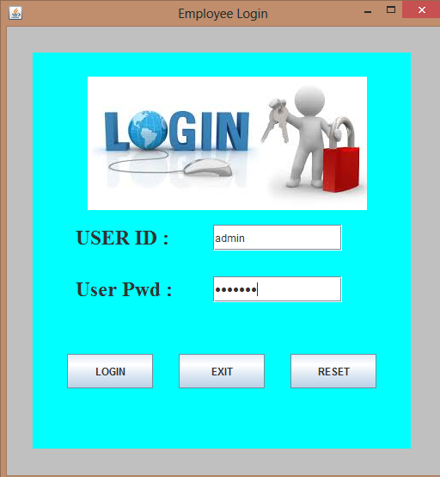
CHANGE
USER
JTextfield
LOGIN
If successfully login, then we switch to MENU page.
EXIT
It Exit out from the system.
RESET
It Clear all Textfield values.
JButton

Slide 10
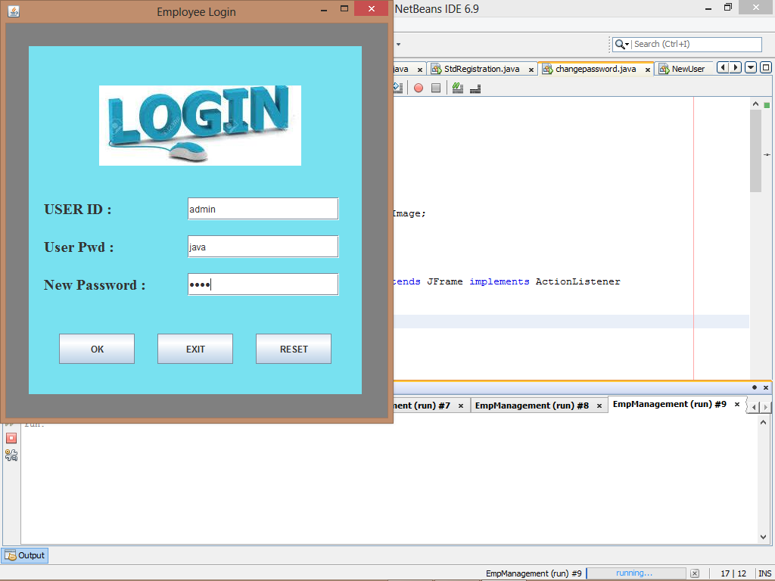
CHANGE
PASSWORD
JTextfield
It Change the password.
OK
EXIT
It Exit from the page.
RESET
It Clear all Textfield values.
JButton

Slide 11
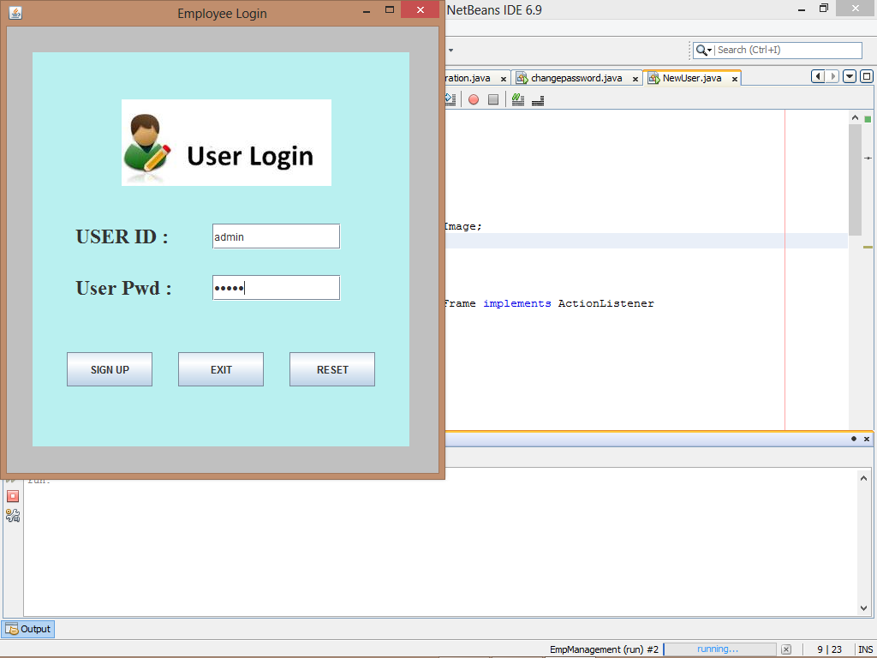
NEW
USER
JTextfield
SIGN UP
It SignUp to New User
and Open Menu.
EXIT
It Exit from the page.
RESET
It Clear all Textfield values.
JButton

Slide 12
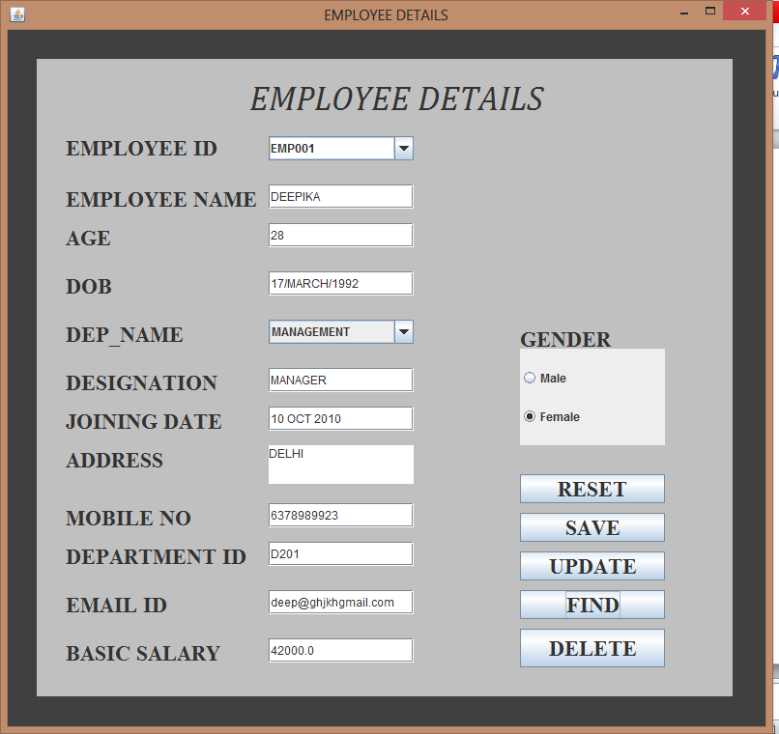
EMPLOYEE DETAILS
JLabel
JCombobox
JTextField
JRadioButton
JButton

Slide 13
EMPLOYEE DETAILS
(JButton)
RESET
It Clear all textfield , set selected index of combox to -1 and set selected of radiobutton setSelected(False).
SAVE
It Save all textfield , combobox and radiobutton isSelected()==true) of values . In database.
It Update all textfield , combobox and radiobutton is Selected()==true ) of values .and also update in database.
UPDATE
It Find all textfield , combobox and radiobutton is Selected()==(true) of values. From database.
FIND
It Delete all textfield and combobox of values from database.
DELETE

Slide 14
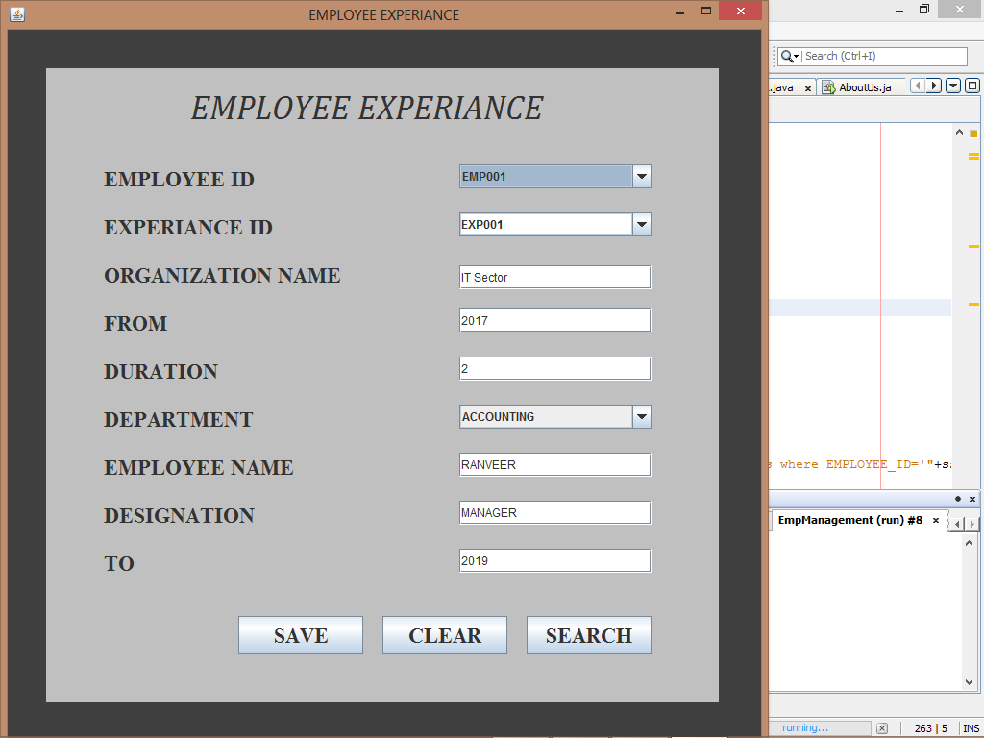
EMPLOYEE EXPERIANCE
JLabel
Combobox
Exp_id.setEditable
(true);
TextField
Add Item
department.setEditable
(false);
Button

Slide 15
EMPLOYEE EXPERIENCE
(JButton)
SAVE
It Save all textfield , combobox , cDepName.addItem() and In Database.
CLEAR
It Clear all textfield and set selected index of combox to 0.
SEARCH
On SEARCH button click, the name of selected employee id retrieve from database which we enter it on employee details form.

Slide 16
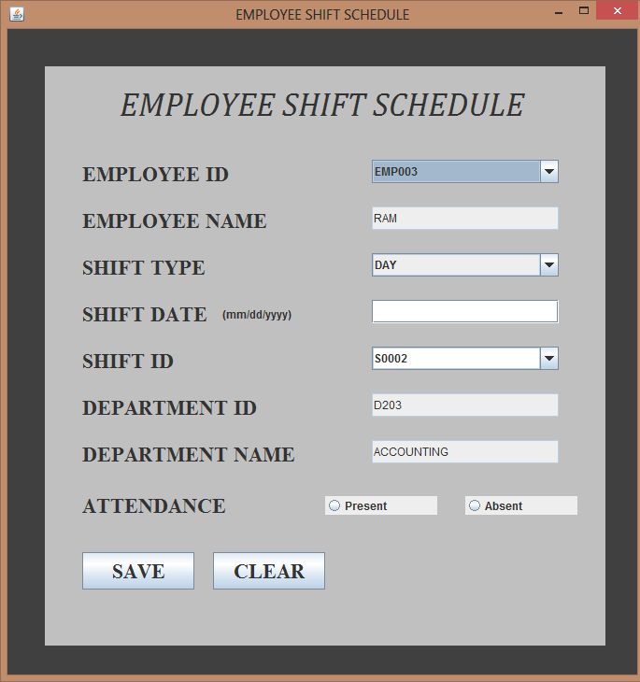
EMPLOYEE SHIFT SCHEDULE
JLabel
Combobox
TextField
cmb_shift_type.add
Item(),setEditable
(false);
cShift_ID.set
Editable(true);
Button

Slide 17
EMPLOYEE SHIFT
(JButton & JCombobox)
Employee Name, Dep. ID, Dep. Name retrieve on selected employee ID which we already enter on employee details.
Employee Name, Dep. ID and Dep. Name these all are JTextfield( setEditable(false) .
Employee ID
SAVE
It Save all textfield , combobox , cShiftType.addItem() and In Database.
CLEAR
It Clear all textfield and set selected index of combox to 0.

Slide 18
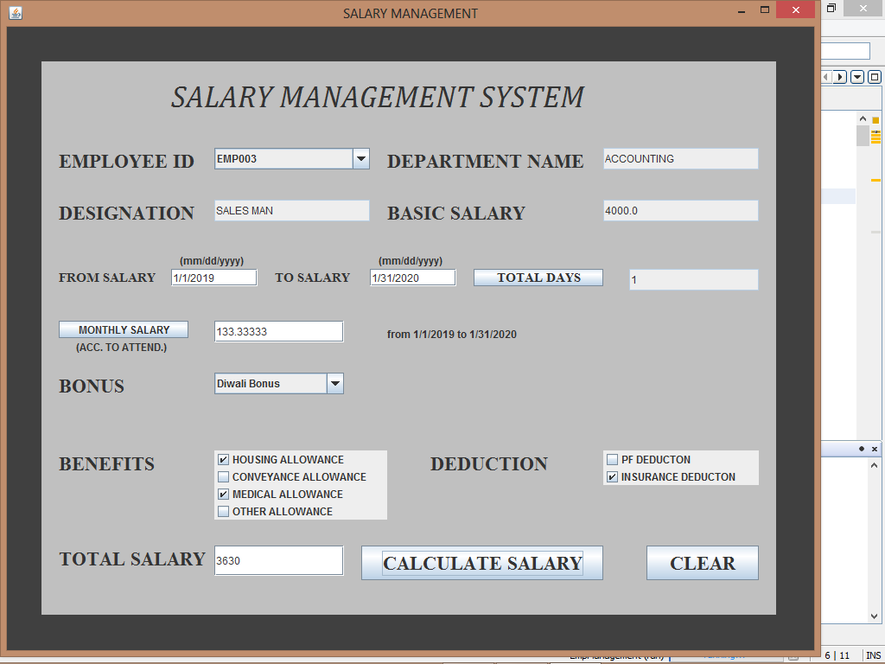
SALARY SYSTEM
JLabel
TextField
JButton
p1.add(LHidden)
ComboBox
cBonus.addItem()
CheckBox
Button

Slide 19
SALARY MANAGEMENT SYSTEM
(JButton & JCombobox)
Employee Name, Dep. ID, Designation and Basic Salary retrieve on selected employee ID which we already enter on employee details.
Employee Name, Dep. ID, Designation and Basic Salary these all are JTextfield( setEditable(false) .
Employee ID
Date
fromd =new SimpleDateFormat("mm/dd/yyyy").parse(sdate);
tod =new SimpleDateFormat("mm/dd/yyyy").parse(sto);
Label
Total Days
According to present days
"select count(ATTENDANCE) from EmpShift where EMPLOYEE_ID='"+sempid+"' and SHIFT_DATE>='"+sfromdate+"' and SHIFT_DATE<='"+stodate+"' and ATTENDANCE='Present'"
Label
MonthlySalary
Monthlysalary=(basicsalary/30)*totaldays
Calculate Salary
Calsalary=monthlysalary+bonus+benefits-deduction
CLEAR
It Clear all textfield and checkbox, set selected index of combox to 0.

Slide 20
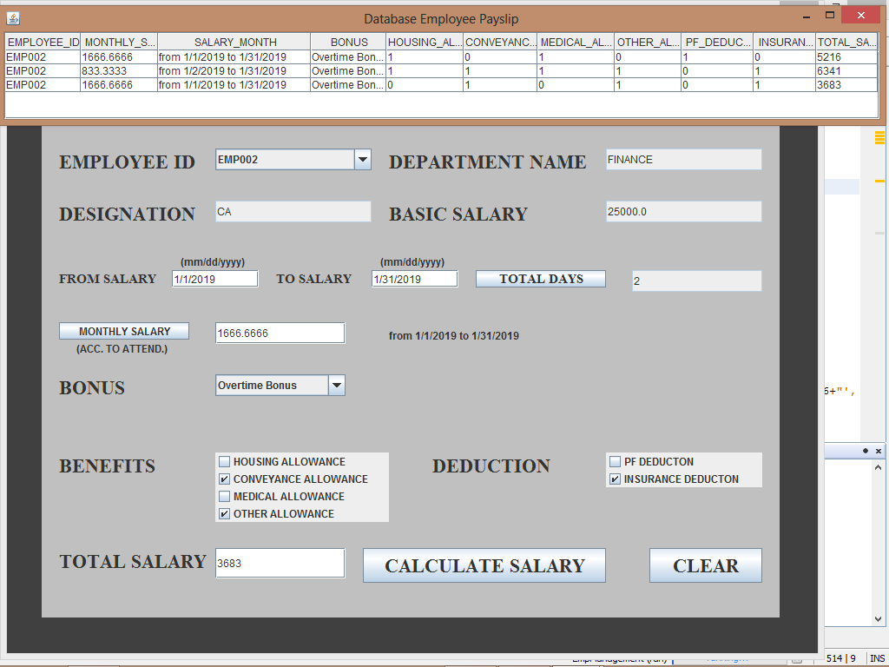
JTable

Slide 21
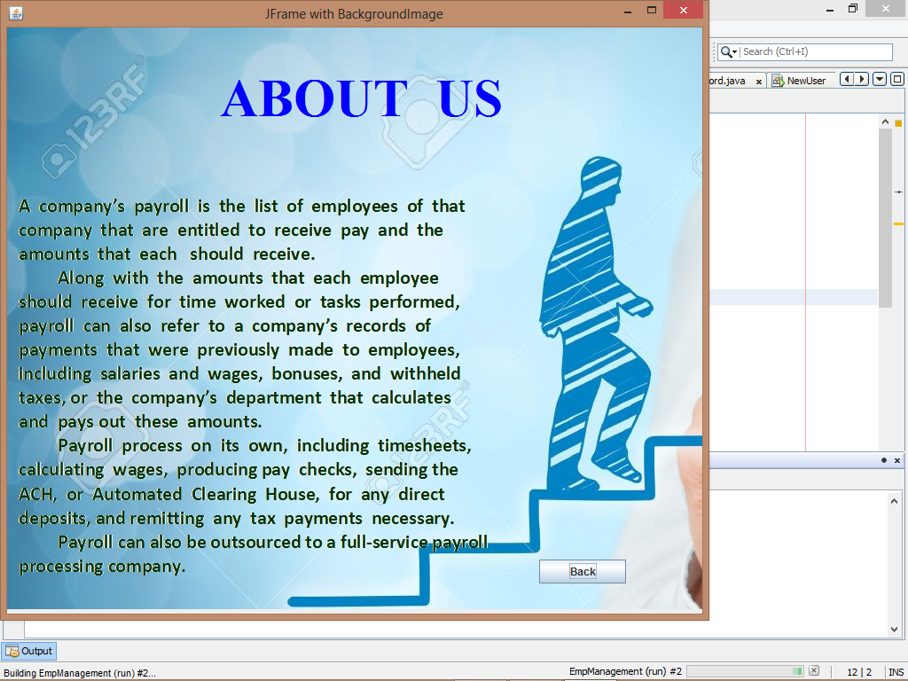
BACK
It Back to Menu
JButton

Slide 22



SYSTEM REQUIREMENTS
Software Requirements :
JRE (Java Runtime Environment)
Front End : Net Beans 6.9
Back End : SQL Server 2008

Slide 23

Why Choose Java Swing
Swing Components are Plateform-independent.
Provides more Components such as Button, Combobox and TextField etc.

Slide 24

limitation
This Software will run on a single PC
Admin and Employee have to sit on the same PC
No Network Connection

Slide 25
ADVANTAGES
Provide Computerized System for maintaining records.
More efficient & reliable.
Less Time Consuming and Easy to Use.
Hugs data Storage with less Computer memory.
Avoid Human error & efforts for Maintaining daily data.
Avoid Data manipulations.
Also avoids Data inconsistency & redundancy.

Slide 26

THANK YOU

